Slide 1
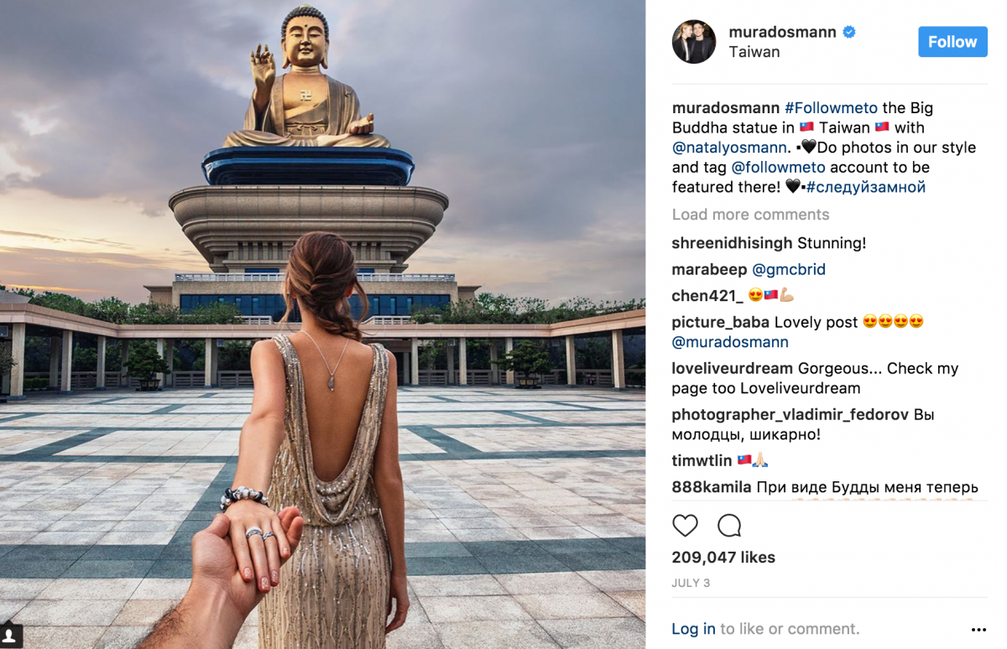
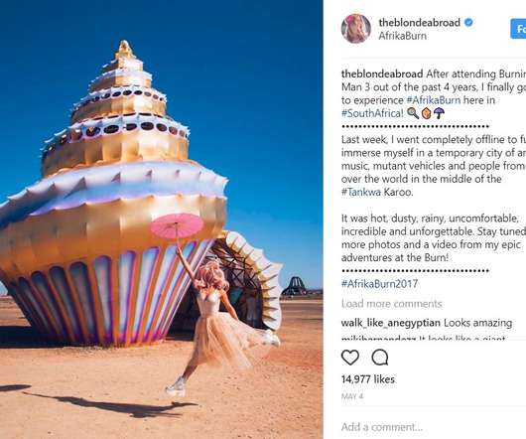
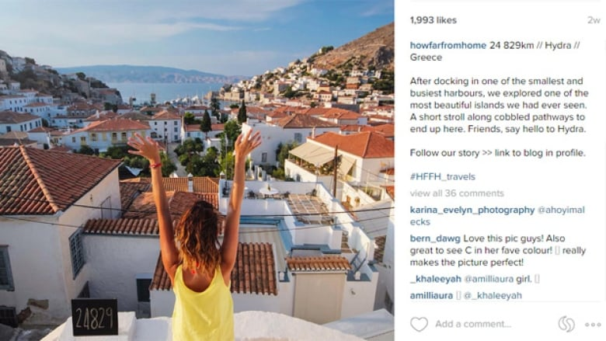
Eyes On Social Media In the Travel Industry
By Chloe Bockstahler

Slide 2
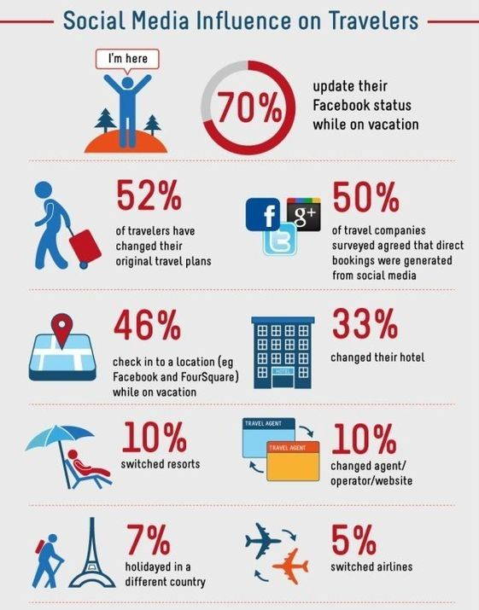
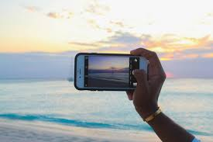








Impact of Social Media
-
We use social media for everything; inspiration, cooking tutorials, fashion, booking trips, for a distraction when we are bored, etc.
Only see what people want us to see about them.
Becoming so prevalent in everyday lives that it has impacted all aspects of our lives, including travel.
limited
Constant desire to share where we are/ best parts of our lives
emphasizes
why companies
want to wonk
with influencers
Cropped so that we don’t see the full spectrum of the place they are visiting
Only seeing image through those persons eyes
Shows a heavy reliance

Slide 3
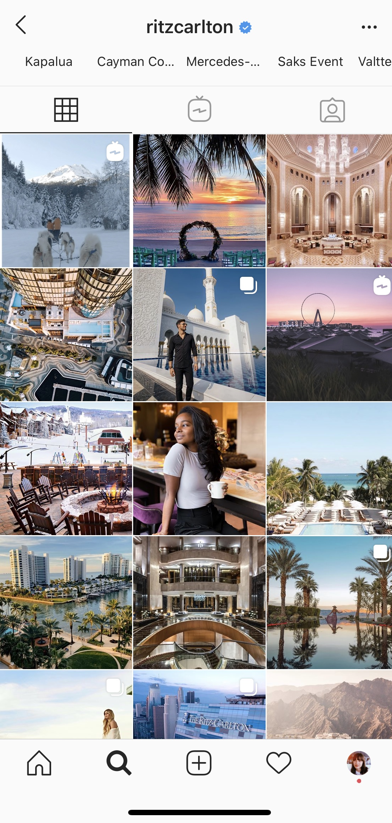
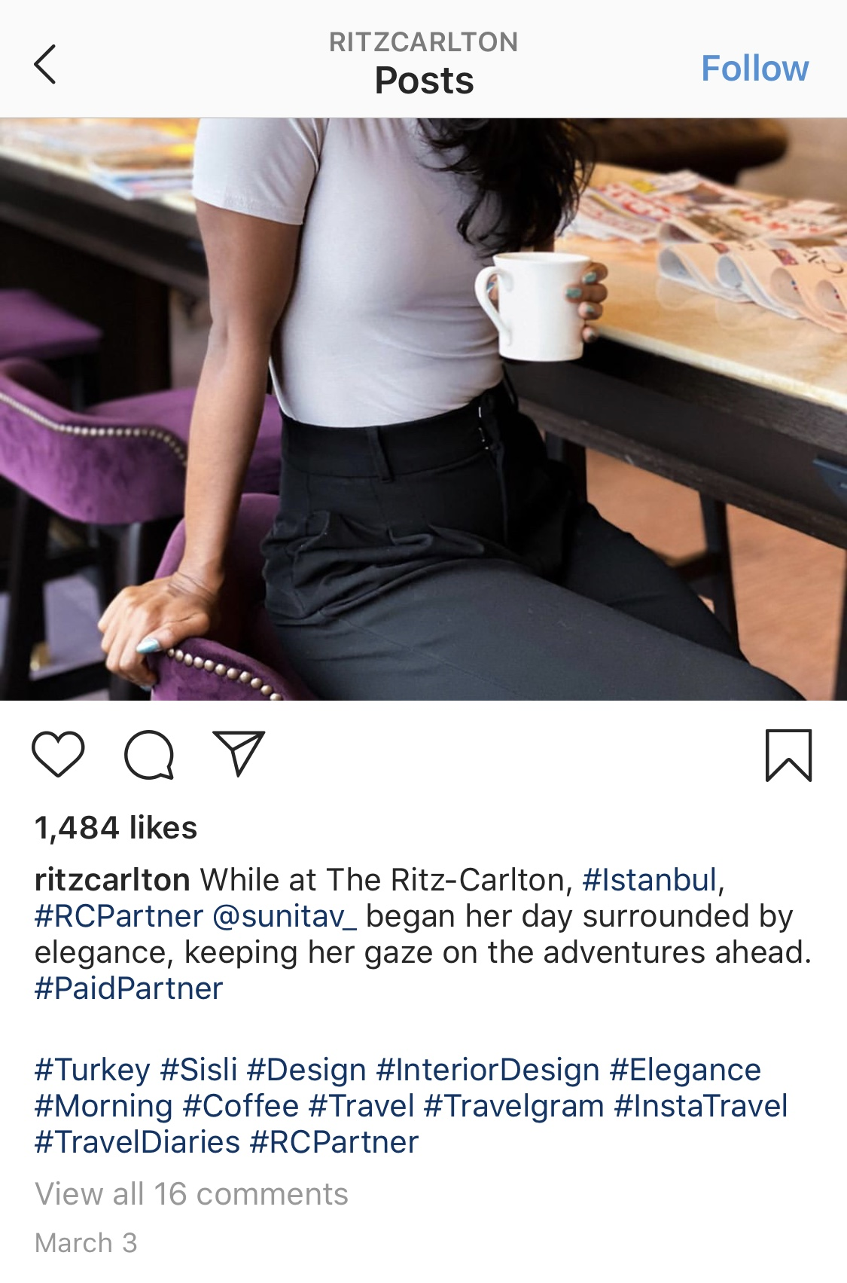


MAIN INVESTIGATION: RITZ CARLTON
Filled with aesthetically pleasing photos, and verified travel influencers, they are making an attempt to reach their audience in a different way.
includes people of
Used specific wording that holds a more elegant tone
all color; all
inclusive
Photos capture the beauty of these places, but not the full picture.
The Ritz Carlton has begun to utilize the growing popularity in social media, which can be seen through their artfully crafted instagram.
Using # to reach an even bigger audience
Influencer with 195K followers
Only shows glimpses of the best parts

Slide 4
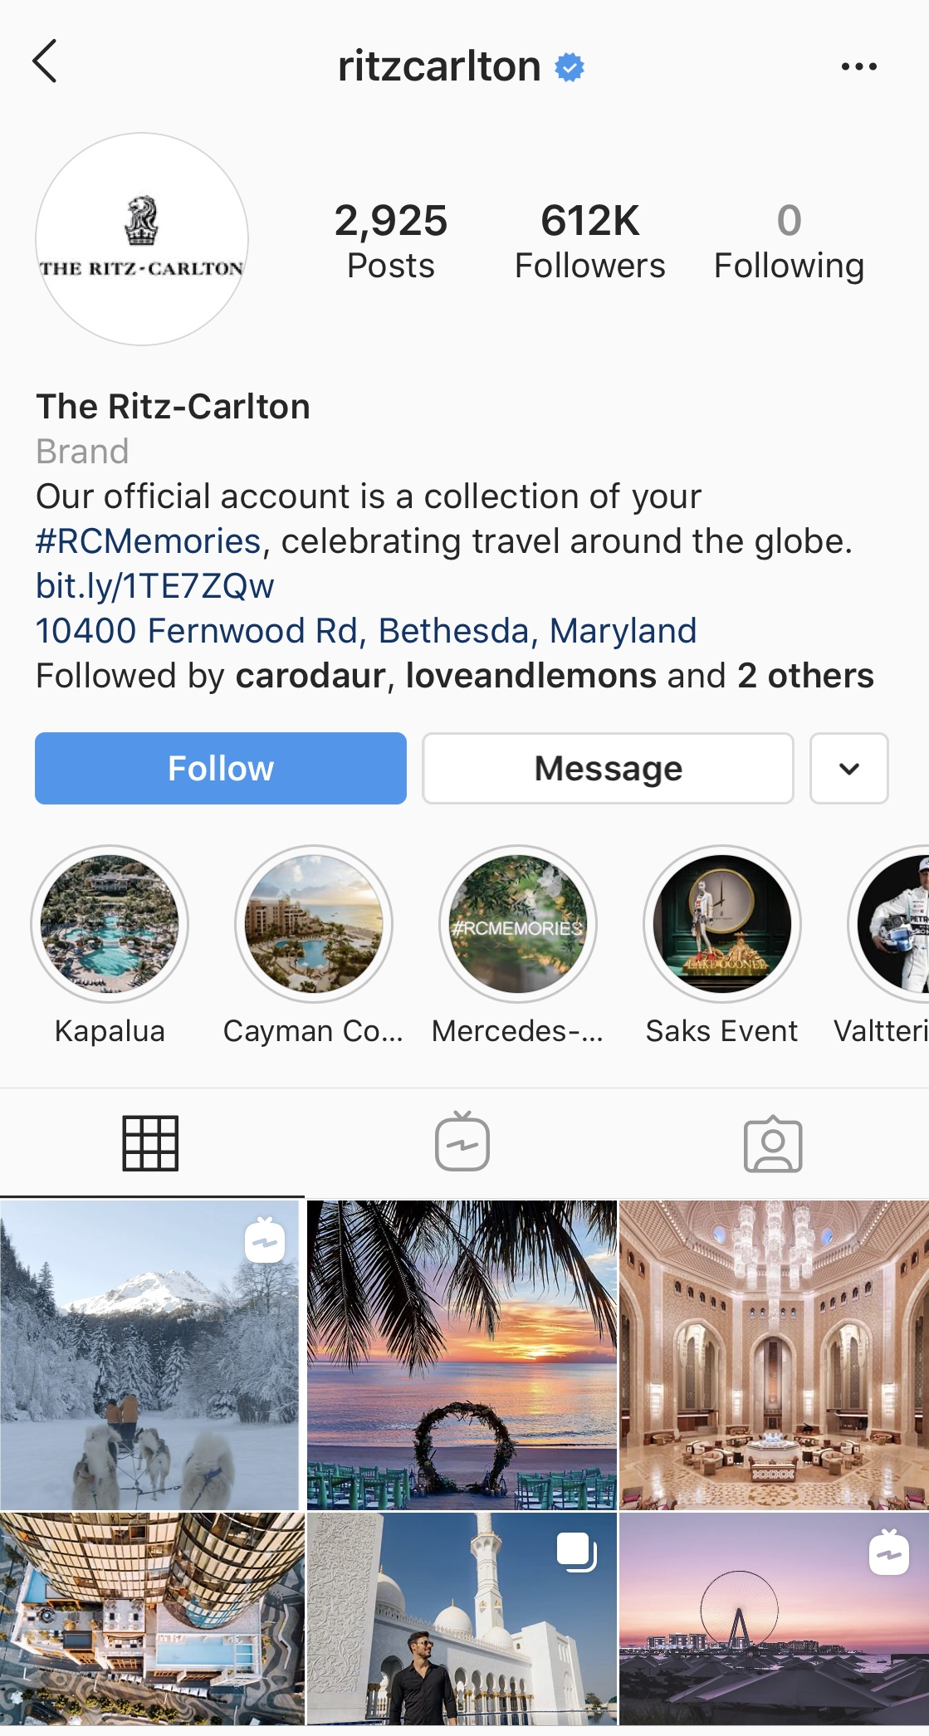
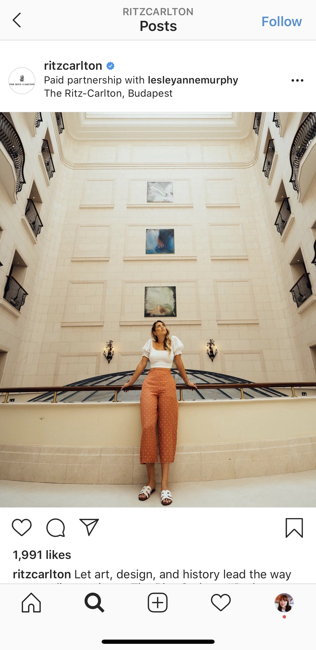






More
personalized
large
following
Many aspects to account for; lighting, pose, outfit, area, etc.
saved
stories
give easy
access to
#
reaches
highlights
l
an even
greater
audience
Appeals to a wide audience + tries to relate to the interests of different people
Using videos,
not only
photos
Very multimodal

Slide 5
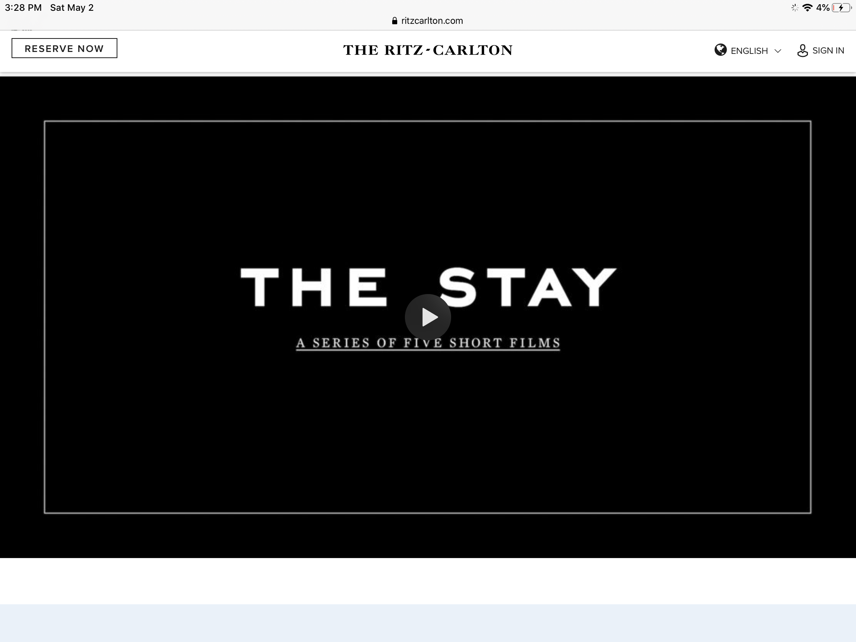
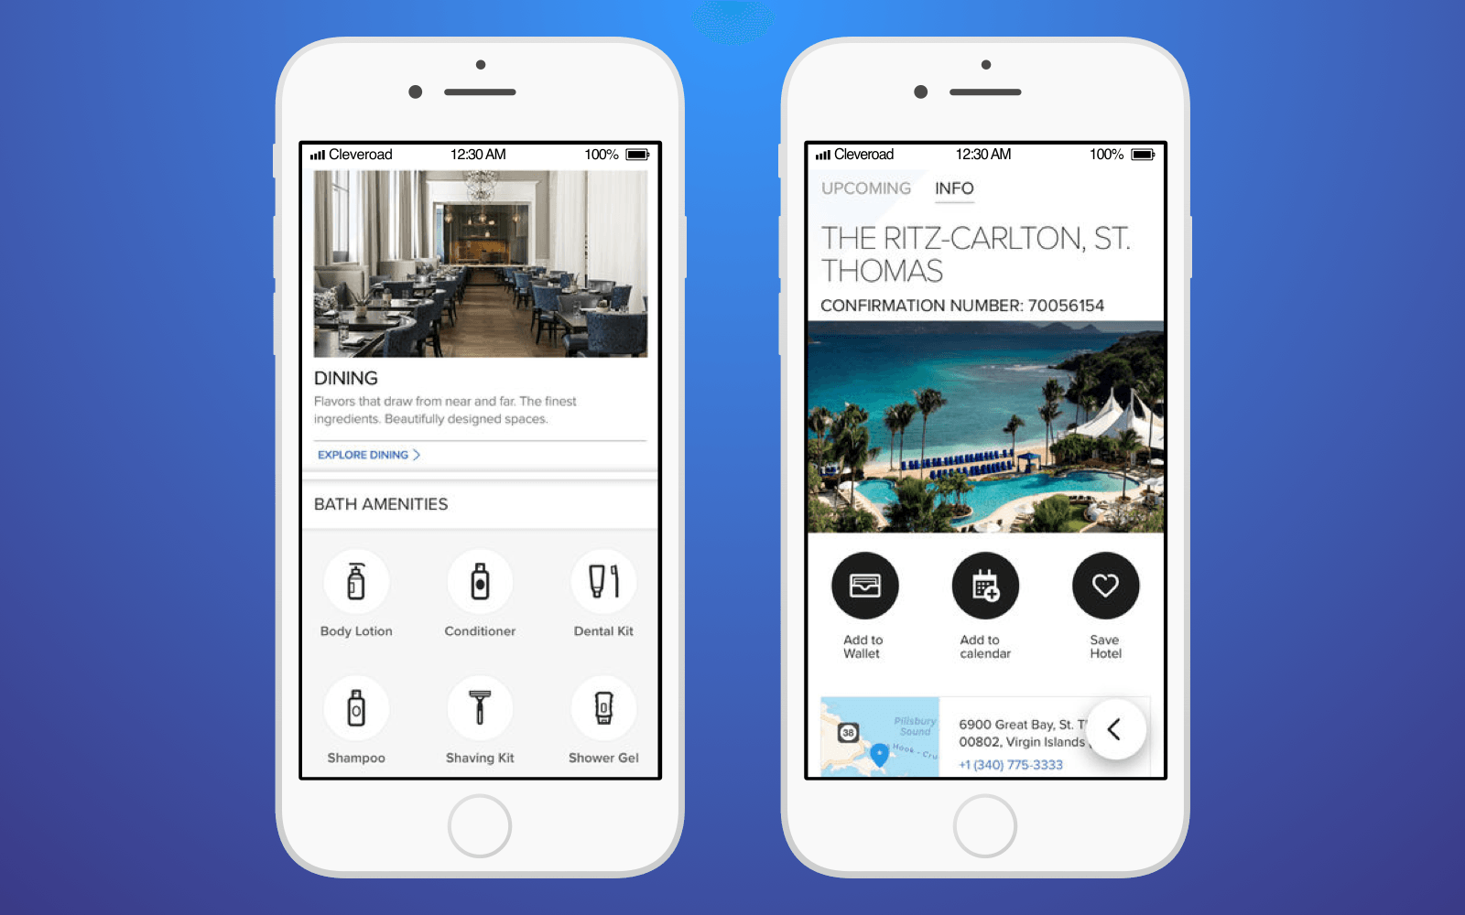
WHY DID THEY DECIDE TO USE SOCIAL MEDIA?
They use multiple sites including Facebook, Instagram and Twitter. Want the travelers to see what they could be experiencing.
Social media is just another outlet to connect with their customers, even when they aren’t physically there staying with them
Over 85% of posts on the Ritz Carlton Instagram channel are “user generated content.”
https://www.ritzcarlton.com/en/hearst
Video curated by emerging screen writing directors showcasing the beauty of multiple Ritz Carlton locations like Geneva, Hong Kong, etc.
As a hotel, the RC wants to be able to interact with their clientele on another level.
Want to use this platform to inspire people to take trips and make memories they wont ever forget.
“Maximize engagement with a global group of luxury travelers.”
Social media is a way to increase the knowledge of their hospitality, and performance.
Want to appeal to guests in a way that keeps them coming back, and share their good experiences with others.
Main focus is on customer service.
Ritz Carlton App

Slide 6

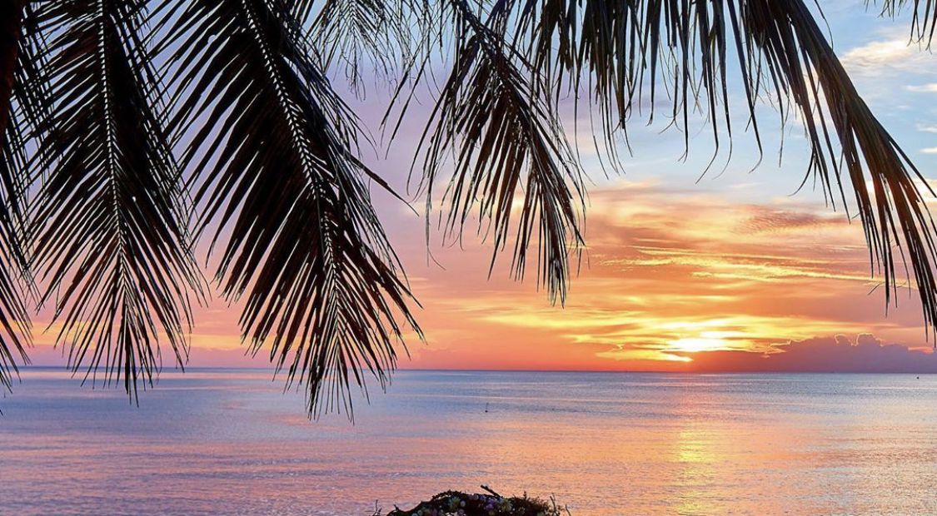
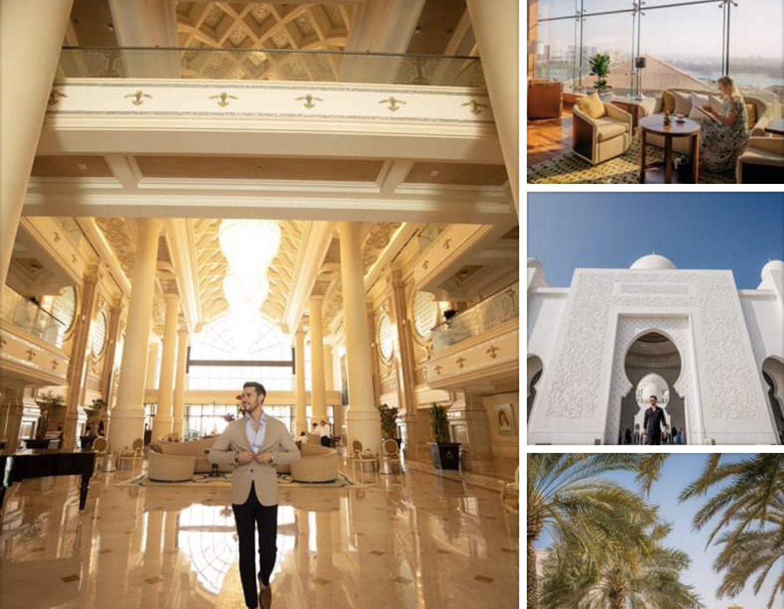
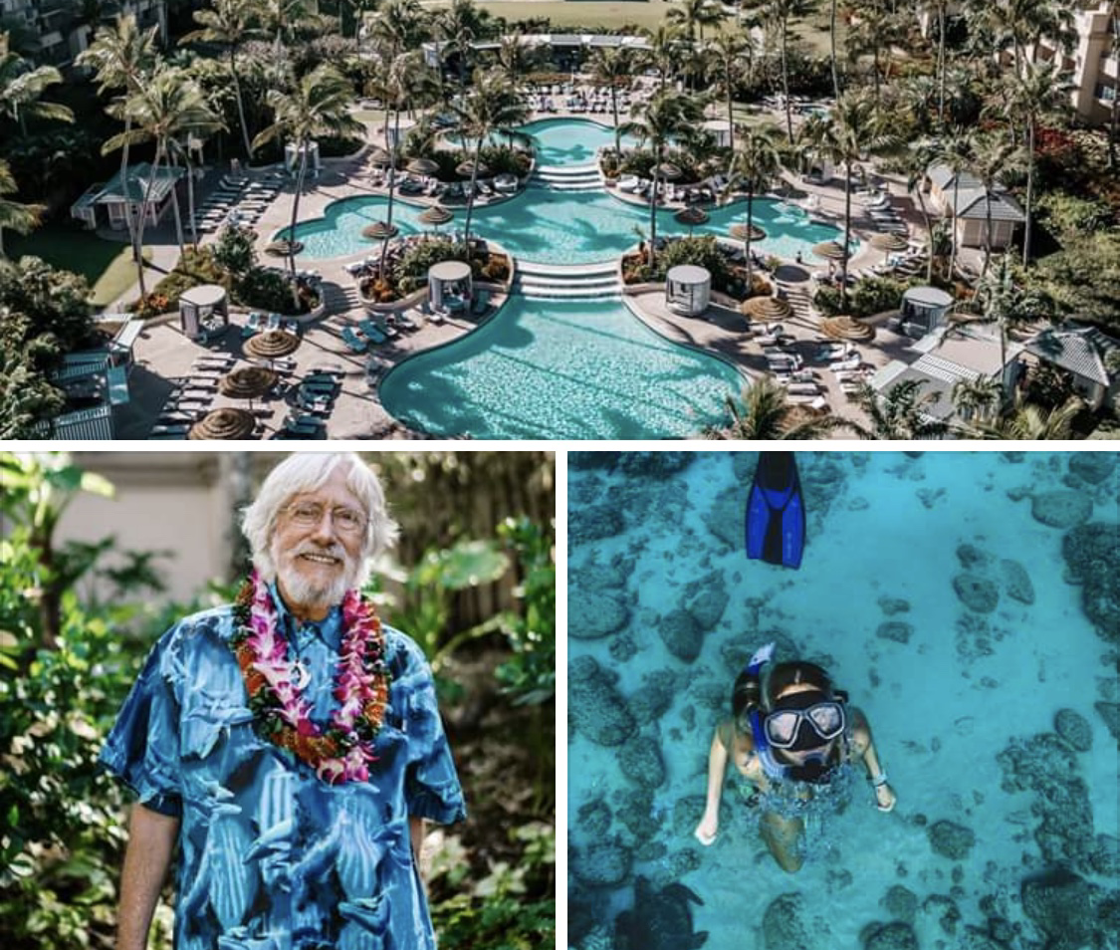
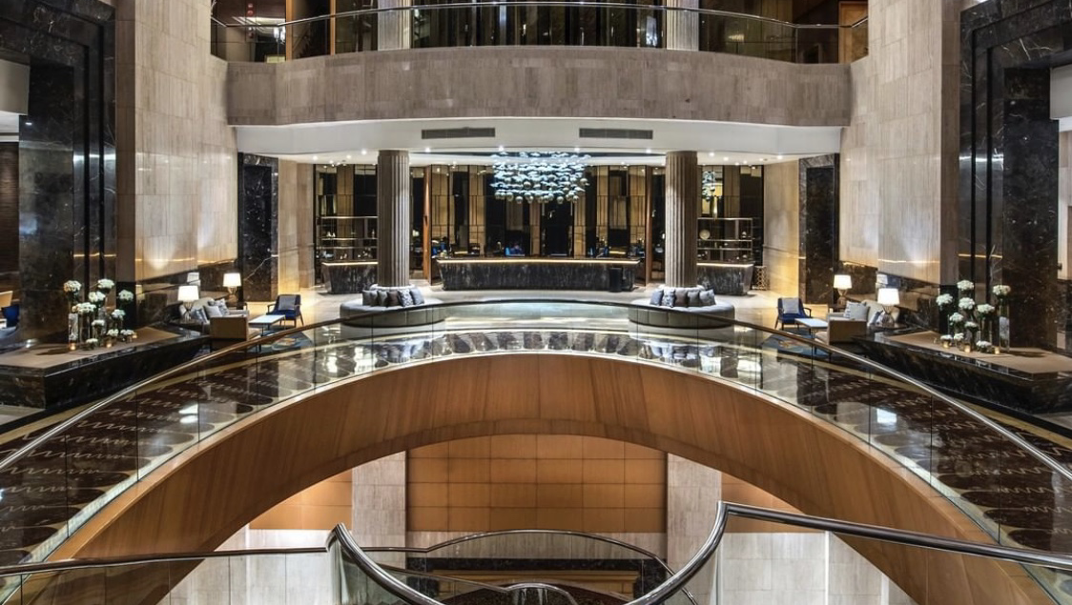
EFFECTS
Now have a following on Instagram of around 612K followers, with an engagement rate of 1.2%
On Twitter, they are one of the more prevalent hotels, posting the most out of any other companies.
Their Facebook page has been able to generate over 6000 inspired conversations about travel.
Surpass guest expectations by being able to respond to customers through these platforms.
“Use of social media strategies has increased engagement with existing guests, which in turn has increased their likelihood to return and to share information about The Ritz-Carlton with their friends.”
Due to these effects, social media has become a necessity in order to interact with customers during an after their stay in order to compete/ keep up with other companies.

Slide 7
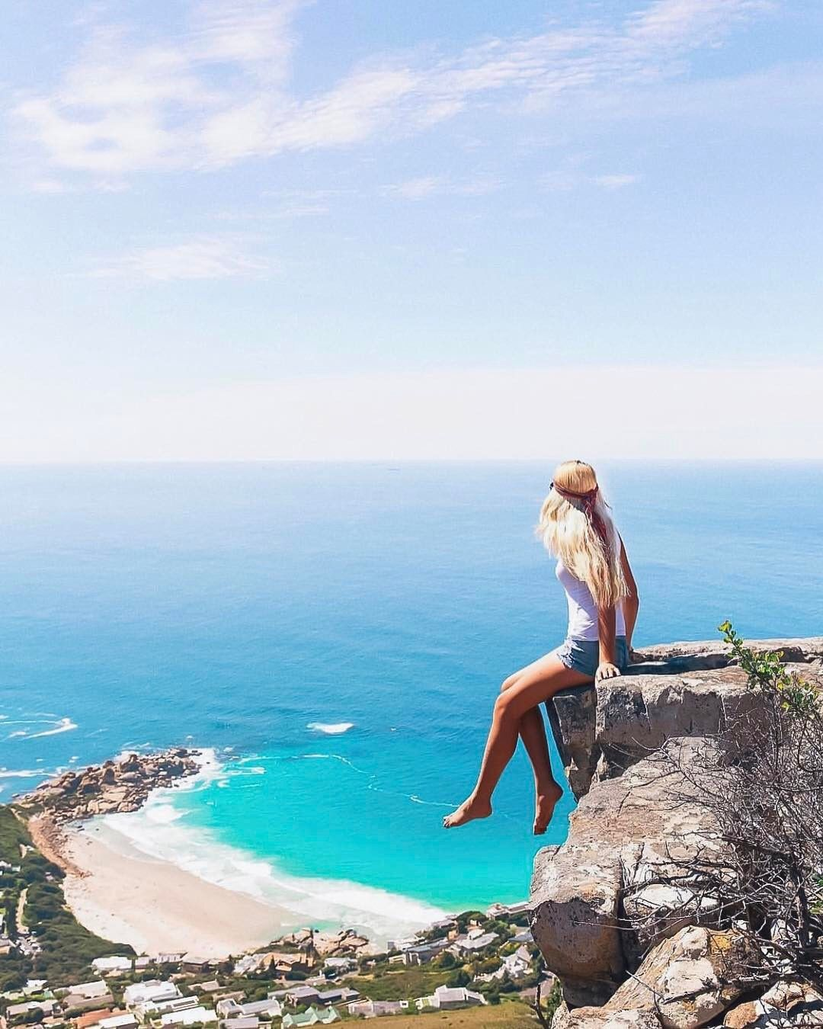
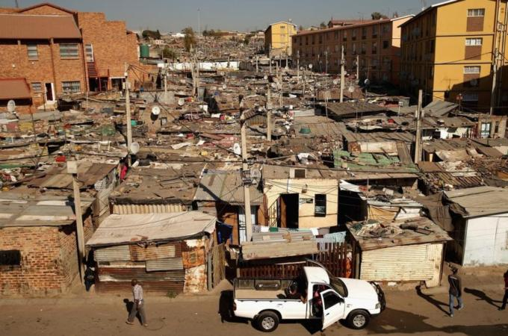
Terministic Screens
*Two very different views of Africa
Terministic screens refers to the way we view the world, and how we share those aspects with others.
“Terministic screens consist of the words we use to represent reality, and as selections from among many conceptual vocabularies, they can lead to different conclusions as to what reality actually is.”
Posed and is aesthetically pleasing
Real + Raw
Although these posts are showing these beautiful places, social media doesn’t show everything.
People want to visit these places thinking they will have the same experience, but they most likely won’t.
Can post the beautiful aspects, but should include a view of all areas of life to show the full spectrum.

Slide 8
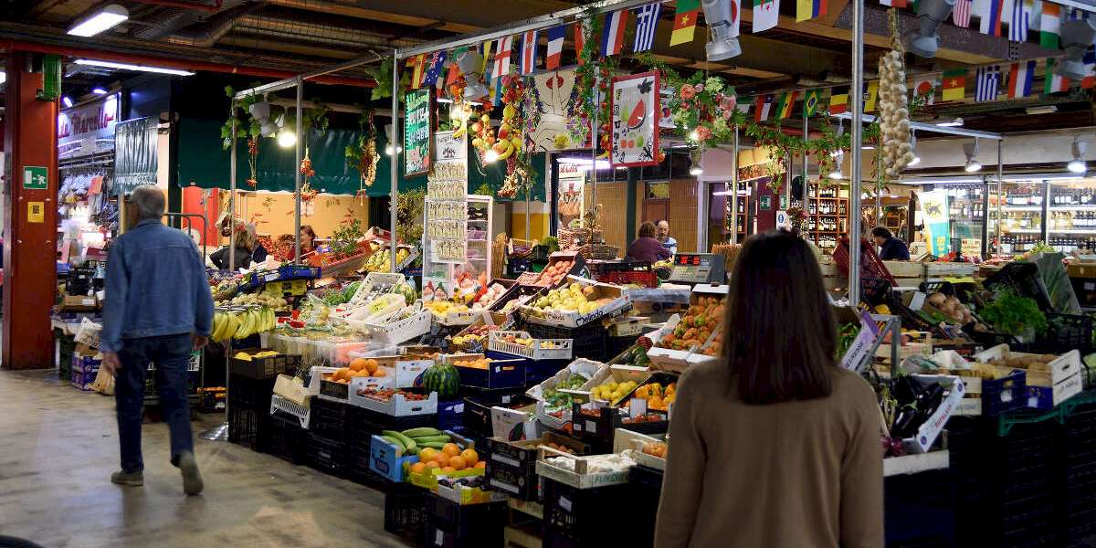
Terministic Screens
“I highly recommend the Penne Pomodoro at Mercato Centrale in Florence. It’s incredibly authentic. You can really sense the unique depth of flavor through the pic. Don’t cheat yourself—get the tiramisu. They bring it out on a chocolate-lined plate! Seriously, it looked so good, I ordered some for myself via Seamless.” – Farah Brook
This quote is pulled from the article “Travel Adventures Through Other People’s Instagram Stories”.
Emphasizes how our perception of places are shaped from the ”screen” that other people view them through.
This examples particularily focuses on the food of a place, and not necessarily the culture and people that make up the place.
This shows how willing we are to trust the opinions of people on social media, and take their word for it.
Penne Pomodoro

Slide 9
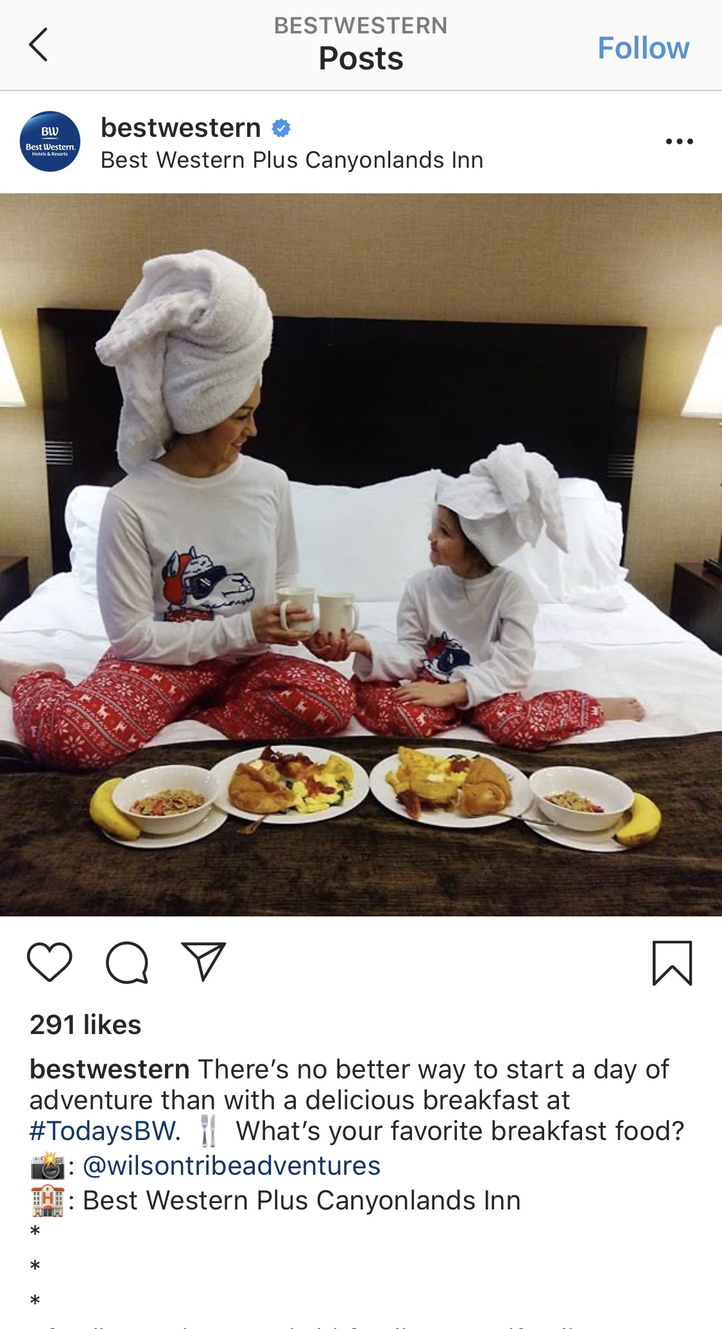
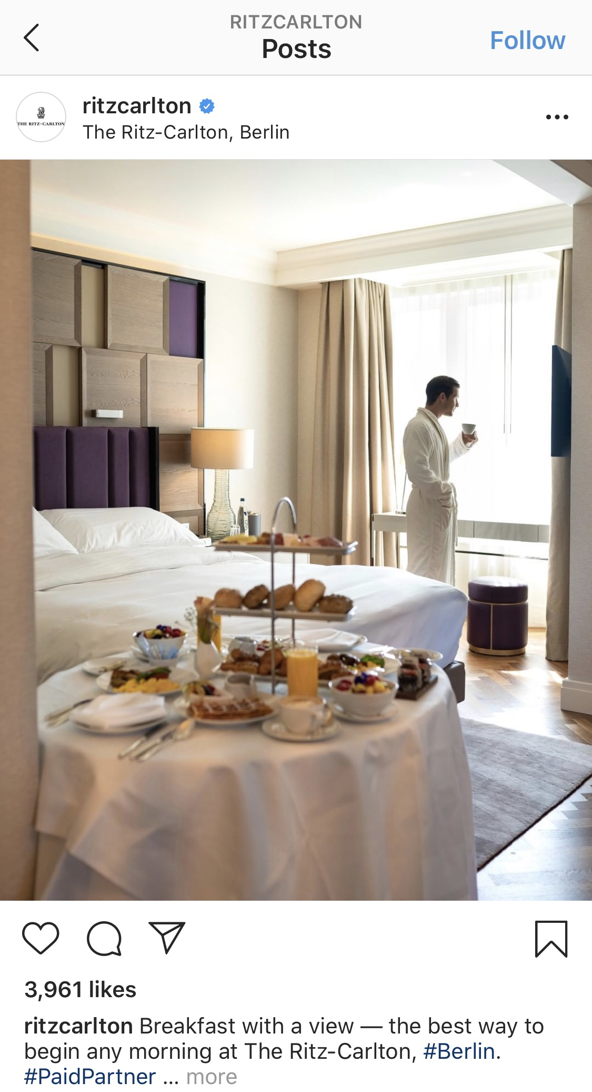
RC and BEST WESTERN: Demographic Differences
Geared more towards single people/ business travelers
Family oriented
Not as focused on aesthetics
In a robe vs. snoopy PJ’s
These hotels have established a reputation for hosting certain travelers.
Targets a different demographic
Geared more towards middle-class
Staged pose
A way to engage in comments

Slide 10
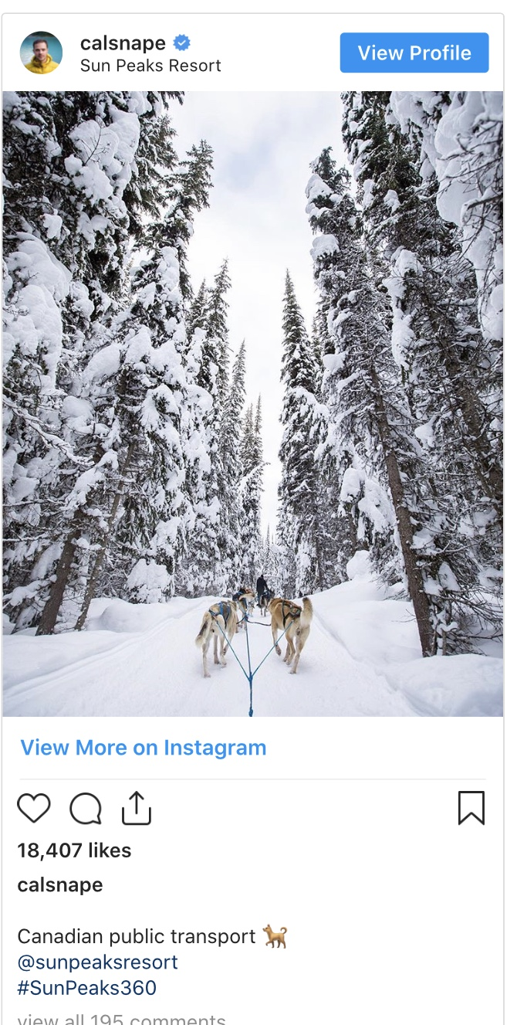
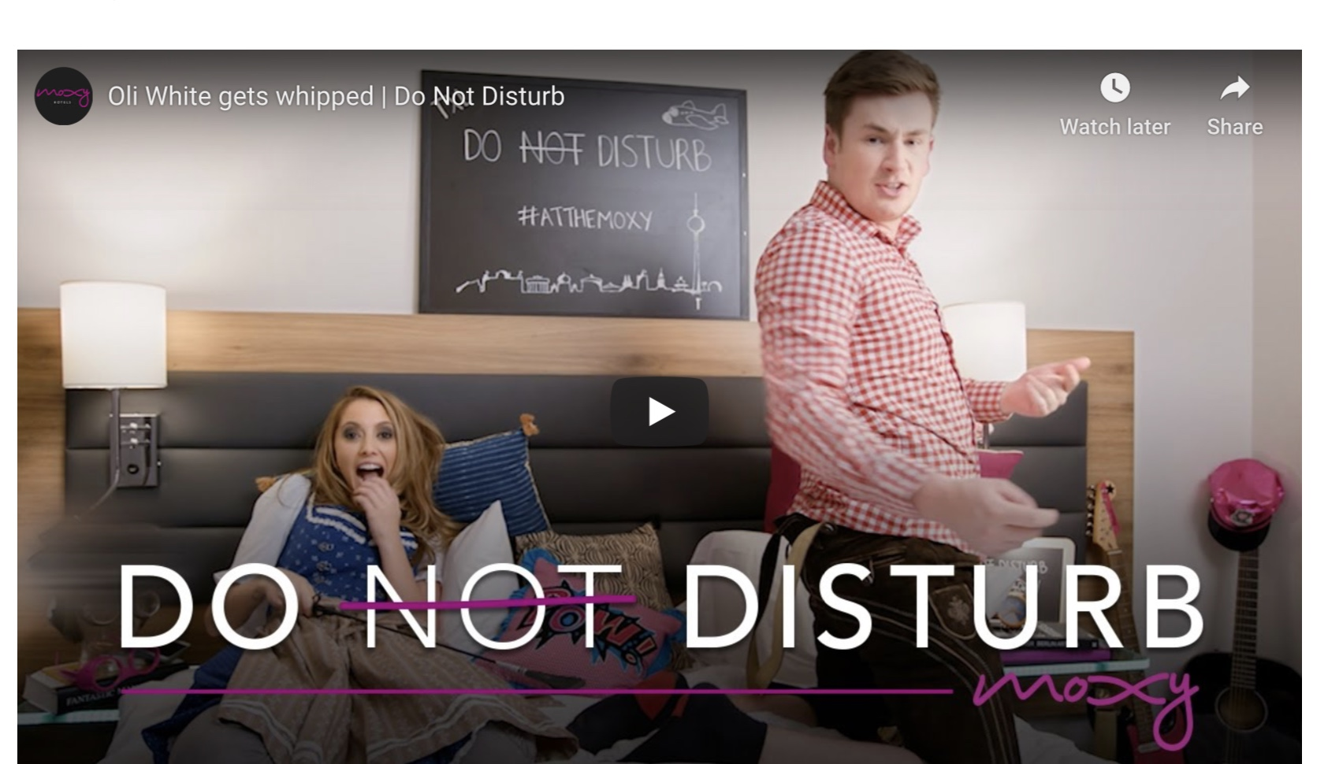
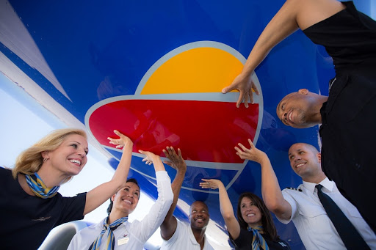
WHO ELSE IS DOING THIS?
Sun Peaks Resort: Used Instagram influencer and photographer Callum Snapple to capture the beauty of their winter attractions at their resort.
- Moxy Hotels: Created their own YouTube Channel where they made a series’s of videos interviewing influencers in a Moxy Hotel Room.
Southwest Airlines: Flew out 12 different influencers to exotic places in exchange for them posting social media content regarding the company. They were able to reach almost 2 million users.

Slide 11
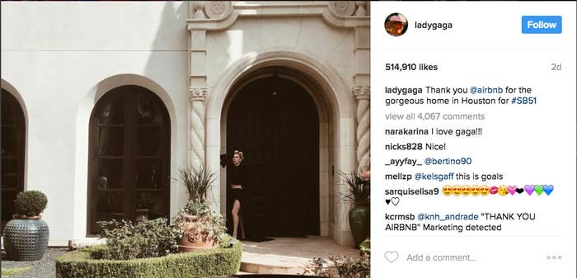
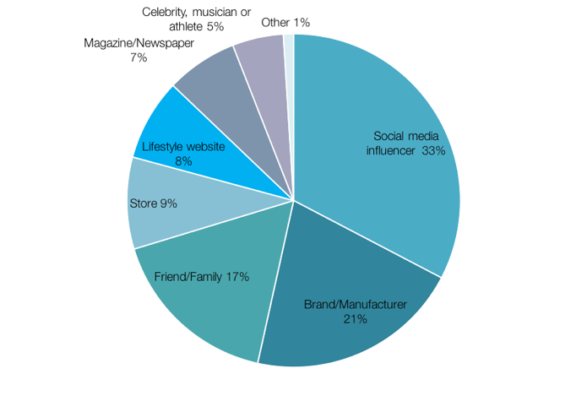



Relationship Between Influencers and Companies+ Numbers
The influencer market is supposed to have reached $10 billion by this year.
“”We pay all of our influencers,” Broadus said, adding that the days of being able to get high quality influencers to post in exchange for free travel or products are long gone. “”
Those who hire these influencers have to strategize when those influencers post, how many times, and what.
“A high number of followers might be much less valuable than a certain type of follower. “
The influencers need to be well rounded, and present on many platforms.
Really about exposure; Lady Gaga posted about Airbnb which received 500,o0o likes.
But this market does breed shady business, as there can be the issue of fake followers; Ritz Carlton had a report that shows that 78% of the followers of their paid influencers are fake.
Biggest chunk of influence on our decisions

Slide 12
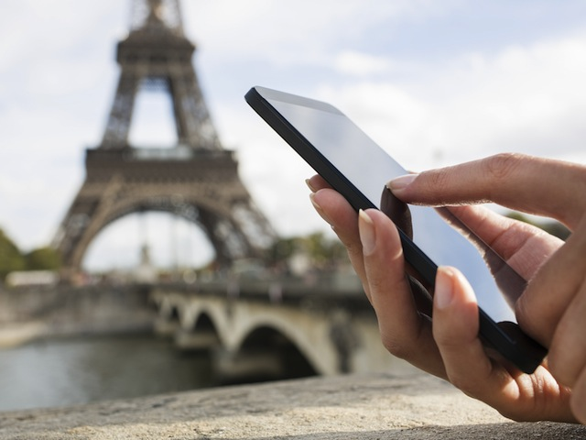
Wrap It Up…
Social media has become so influential and important in our everyday lives that it has changed the way we decide to travel, where, and with what companies.
This has become a new opportunity for companies to connect to their clients even more and become more relevant in everyday lives.
Ritz Carlton has been innovative enough to do things like make an app, and work with social media influencers to spread the word.
They now have more access to help their customers and make their stay as best as possible.
Influencers have created a whole new business/ market and have begun to make money, and even get free trips.
Social media has altered how we view travel, as many posts tend to focus on the best parts of travel, rather then the reality of what they are seeing.

Slide 13
Sources
https://www.travelweekly.com/Travel-News/Travel-Technology/social-media-influencers
https://www.travelmindset.com/20-influencer-marketing-examples/
https://www.businessinsider.com/luxury-hotels-and-social-media-the-ritz-carlton-hotel-company-2012-20
https://www.newyorker.com/humor/daily-shouts/travel-adventures-through-other-peoples-instagram-stories
https://methods.sagepub.com/reference/the-sage-encyclopedia-of-communication-research-methods/i14586.xml

